Slide 1

Credit Card Fraud Detection Model – Machine Learning Project
Tanmay D Mangrulkar
© All rights reserved by Fireblaze Technologies Pvt. Ltd.

Slide 2
Introduction
This dataset is a comprehensive credit card fraud detection dataset designed to analyze and predict fraudulent transactions in real-world financial systems. It contains 50,000 transaction records with 35 features capturing a wide range of transaction, customer, merchant, and behavioral details. Each record represents a single credit card transaction, including attributes such as transaction amount, account balance, card type, entry mode, merchant details, and transaction frequency patterns. The most important feature is_fraud,which serves as a target variable indicating whether a transaction is legitimate (0)
or fraudulent(1).
I cleaned the data,removed unwanted columns and tested different models like Logistic Classification, Decision Tree, KNN and Random Forest. The Decision Tree model gave the most accurate results.This project help me to understand how machine learning can solve real world problems by comparing and analyzing different features and past records predicts whether fraudulent transactions has occurred or not.
© All rights reserved by Fireblaze Technologies Pvt. Ltd.

Slide 3
Dataset Description
The dataset includes Columns :
transaction_id: Unique identifier for each transaction.
timestamp: Date and time when the transaction occurred.
customer_id: Unique ID assigned to each customer.
age: Age of the cardholder.
gender: Gender of the cardholder.
card_type: Type of credit card used(e.g. debit,credit,prepaid).
card_status: Status of the card(active,blocked,expired etc).
account_balance: Account balance before the transaction.
© All rights reserved by Fireblaze Technologies Pvt. Ltd.

Slide 4
Dataset Description
The dataset includes Columns :
amount: Transaction Amount
last_transaction_amount: Amount of the previous transaction by the same customer.
fraud_amount_ratio: Ratio of fraudulent amount to total amount.
is_fraud: Target variable; 1 if transaction is fraudulent, 0 otherwise
fraud_type: Type/category of fraud detected.
merchant_id: Unique ID of the merchant.
merchant_category: Category of the merchant(e.g. retail,online).
mcc: Merchant category code
© All rights reserved by Fireblaze Technologies Pvt. Ltd.

Slide 5
Dataset Description
The dataset includes Columns :
merchant_country: Country where the merchant is located.
merchant_location: Detailed location of the merchant.
avg_merchant_distance_km: Average distance of merchant from customer.
terminal_id: ID of the terminal where the transaction was processed.
pos_device: Type of POS device used.
entry_mode: Mode of card entry(chip, swipe, online etc).
card_present: Indicates if the physical card was present during transaction.
is_international: 1 if the transaction is international, else 0
© All rights reserved by Fireblaze Technologies Pvt. Ltd.

Slide 6
Dataset Description
The dataset includes Columns :
currency : Currency used in the transaction.
ip_address: IP address of the transaction device.
device_fingerprint: Unique identifier of the device used.
browser: Browser used for the transaction (for online payments).
zipcode: Customer’s postal code.
num_previous_transaction_24h: Number of previous transactions in last 24 hours.
txs_past_1hr: Number of transactions in past 1 hour.
txs_past_24hr: Number of transactions in past 24 hours.
avg_transaction_amount_30d: Average transaction amount in the last 30 days.
std_transaction_amount_30d: Standard transaction amount in the last 30 days.
days_since _account_open: Days since the customer’s account was opened.
© All rights reserved by Fireblaze Technologies Pvt. Ltd.

Slide 7
Problem Statement
Credit card fraud is a major challenge in the financial industry, causing significant financial losses to banks, merchants, and customers. As digital transactions increase globally, detecting fraudulent activities in real time has become critical.
The task is to build a machine learning solution that can:
Understand and analyze transaction patterns.
Detect suspicious or abnormal transactions based on historical data.
Accurately classify transactions as fraudulent or not.
Provide insights into the factors contributing to fraud to support better fraud prevention strategies.
© All rights reserved by Fireblaze Technologies Pvt. Ltd.

Slide 8
Problem Statement
Load Dataset – Imported credit card fraud dataset with 50,000 records.
Code : import pandas as pd
import numpy as np
import matplotlib.pyplot as plt
import seaborn as sns
from sklearn.preprocessing import LabelEncoder
from sklearn.model_selection import train_test_split
from sklearn.linear_model import LogisticRegression
from sklearn.neighbors import KNeighborsClassifier
from sklearn.tree import DecisionTreeClassifier
from sklearn.ensemble import RandomForestClassifier
from sklearn.metrics import accuracy_score,recall_score,precision_score,confusion_matrix,f1_score
from imblearn.over_sampling import RandomOverSampler
from sklearn.model_selection import cross_val_score
© All rights reserved by Fireblaze Technologies Pvt. Ltd.

Slide 9
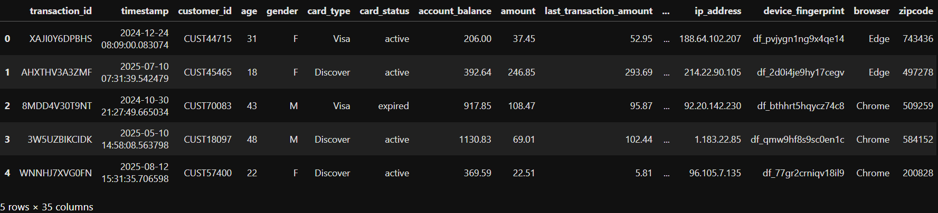
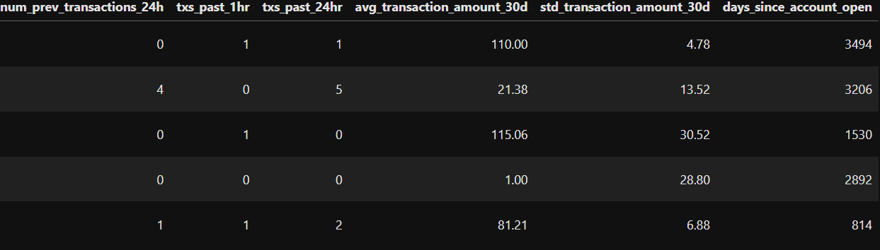
Problem Statement
Load Dataset
Code : df = pd.read_csv(r"C:\Users\tanma\Downloads\credit_card_fraud_dataset_50k.csv")df.head()
© All rights reserved by Fireblaze Technologies Pvt. Ltd.

Slide 10
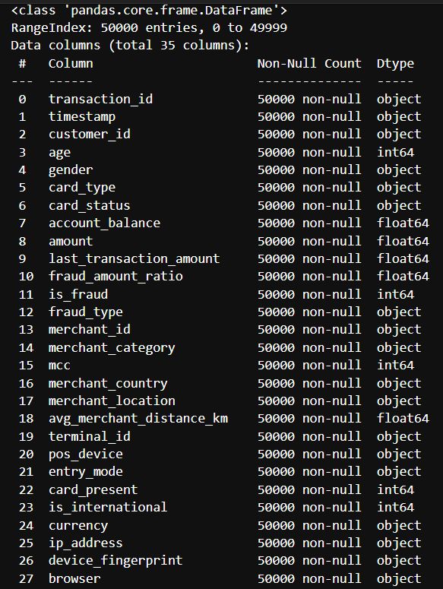
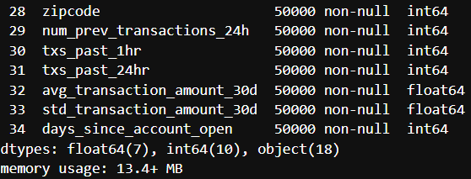
Problem Statement
3. Find the type of dataset.
Code :df.info()
© All rights reserved by Fireblaze Technologies Pvt. Ltd.

Slide 11
Problem Statement
4. Clean Dataset – Checked data types andremoved unnecessary column('transaction_id', 'timestamp', 'customer_id', 'merchant_id', 'terminal_id', 'ip_address', 'device_fingerprint', 'zipcode', 'browser', 'merchant_location’)
Code : drop_cols = ['transaction_id', 'timestamp', 'customer_id', 'merchant_id', 'terminal_id', 'ip_address', 'device_fingerprint', 'zipcode', 'browser', 'merchant_location']
df_cleaned = df.drop(drop_cols,axis=1,errors='ignore’)
print("Remaining columns:", df_cleaned.columns.tolist())
print("Total columns left:", len(df_cleaned.columns))
© All rights reserved by Fireblaze Technologies Pvt. Ltd.

Slide 12
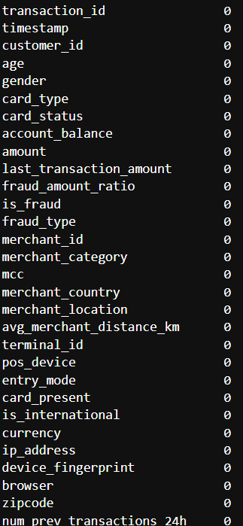

Problem Statement
5. Check Null Data – Verified no missing values.
Code : df.isnull().sum()
© All rights reserved by Fireblaze Technologies Pvt. Ltd.

Slide 13
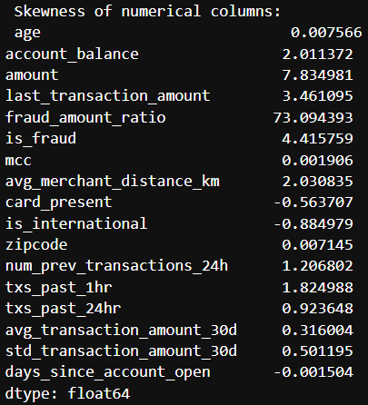
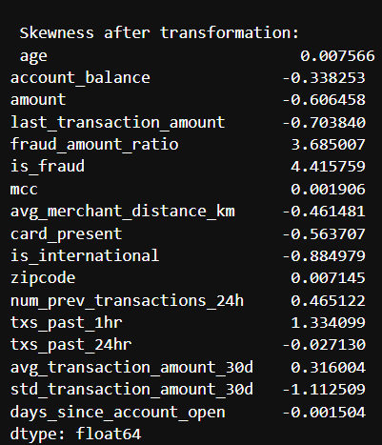
Problem Statement
6. Checked skewness and tried to reduce it by applying log transformation
Code : numeric_cols = df.select_dtypes(include=[np.number]).columns
# Check skewnesss
skew_values = df[numeric_cols].skew()
print(" Skewness of numerical columns:\n", skew_values)
After applying log transformation:-
for col in numeric_cols: if abs(skew_values[col]) > 0.5:
# Only transform skewed columns
df[col] = np.log1p(df[col])new_skew = df[numeric_cols].skew()
print("\n Skewness after transformation:\n", new_skew)
© All rights reserved by Fireblaze Technologies Pvt. Ltd.

Slide 14
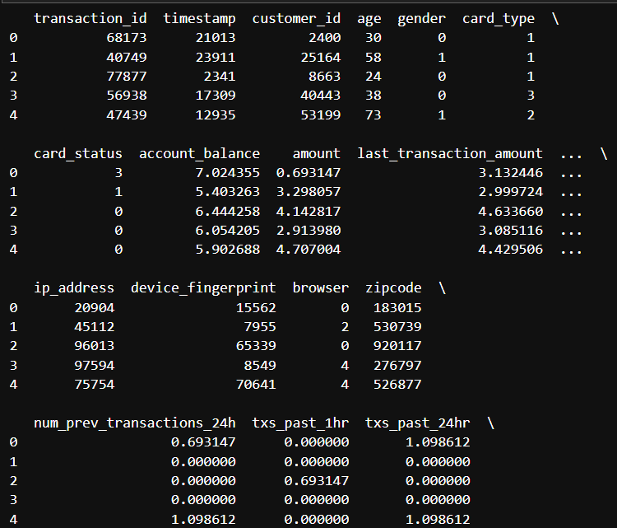
Problem Statement
7. Applied Label Encoding to convert each column to numerical
Code:LE=LabelEncoder()
categorical_cols= df.select_dtypes(include=['object','category']).columns
for col in categorical_cols:
df[col] = LE.fit_transform(df[col])
print(df.head())
© All rights reserved by Fireblaze Technologies Pvt. Ltd.

Slide 15
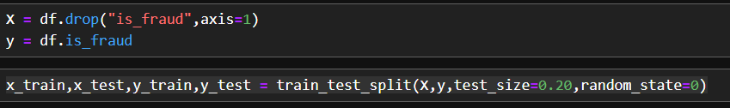
Problem Statement
9. Split Dataset – Divided data into training(80%) and testing(20%)
Code : X = df.drop("is_fraud",axis=1)
y = df.is_fraud
x_train,x_test,y_train,y_test = train_test_split(X,y,test_size=0.20,random_state=0)
© All rights reserved by Fireblaze Technologies Pvt. Ltd.

Slide 16
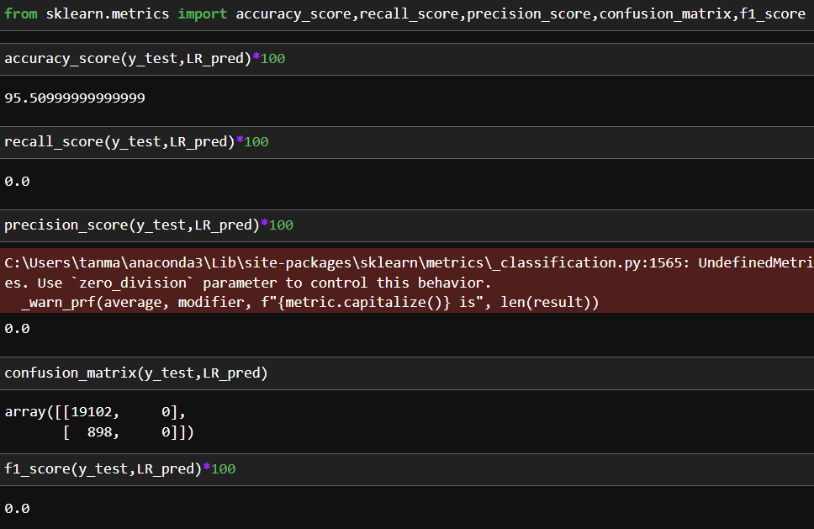
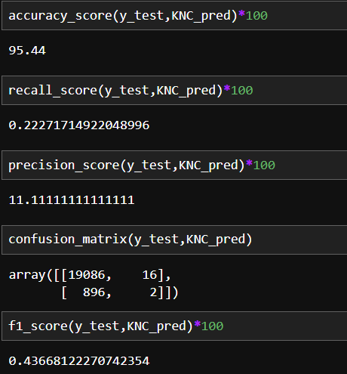
Problem Statement
10. Train Models – Applied Logistic Regression,Decision Tree,KNN and Random Forest
Code:Logistic Regression KNN
© All rights reserved by Fireblaze Technologies Pvt. Ltd.

Slide 17
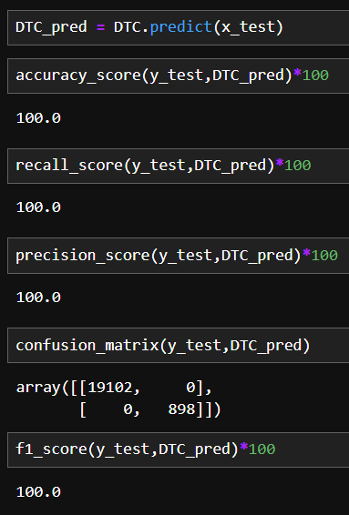
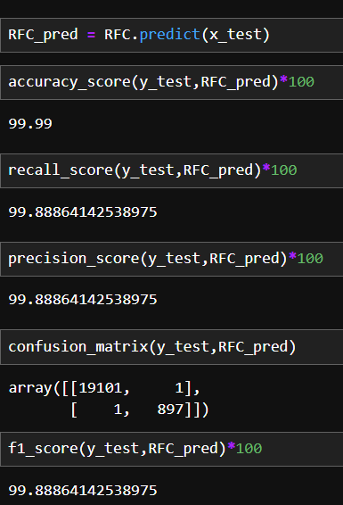
Problem Statement
10. Checked which model shows high accuracy
Code : Decision Tree Random Forest
© All rights reserved by Fireblaze Technologies Pvt. Ltd.

Slide 18
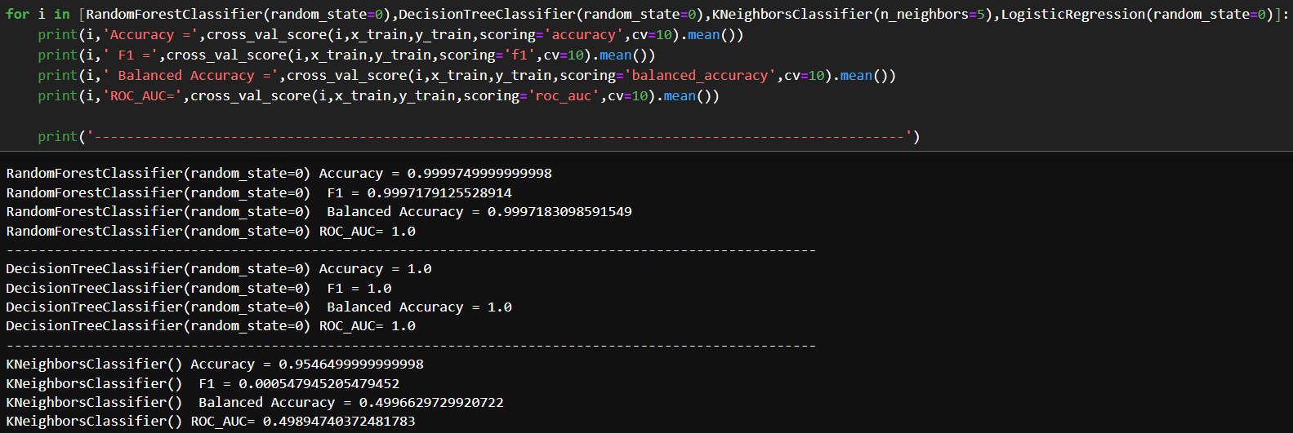
Problem Statement
11. Checked cross-val score
Code:
© All rights reserved by Fireblaze Technologies Pvt. Ltd.

Slide 19
Challenges Faced
Presence of missing values in critical columns like side-effect severity and lifestyle factors.
Imbalanced classes in disease types and side-effect severity levels.
Mixed data types(numeric,categorical,binary) requiring different preprocessing methods.
Difficulty in capturing casual relationships between drug dosage and side effects.
Regional imbalance in hospital availability and patient records.
© All rights reserved by Fireblaze Technologies Pvt. Ltd.

Slide 20
Thank you
© All rights reserved by Fireblaze Technologies Pvt. Ltd.

